Slide 1

#LifeKoKaroLift
Python Crash Course
Session – 5:
Python Data Structures - 2

Slide 2



Instructor: Devesh Singh
LinkedIn: https://www.linkedin.com/in/deveshhh3/
Instagram: https://www.instagram.com/deveshhh3/
GitHub: https://github.com/deveshhh3/

Slide 3
What You’ll Learn
1
Set/Tuples/Dictionary
2
Exercises

Slide 4
Understanding Data Structure
Data Structure
Data Structures are a way of organizing and storing data so that they can be accessed and worked with efficiently.
Common Operations performed on Data Structures:
Add an element
Update or Delete an element
Traverse
Sort the elements
Search for an element

Slide 5









Slide 6












Slide 7


















Slide 8




Slide 9












Slide 10
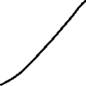




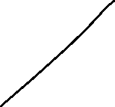
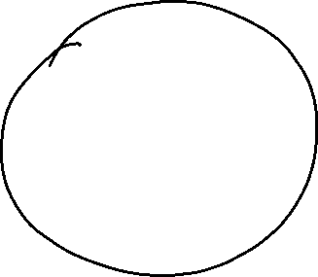


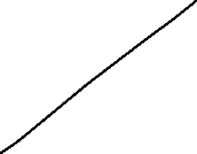





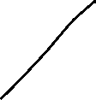

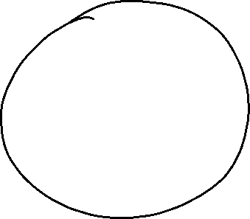

Slide 11




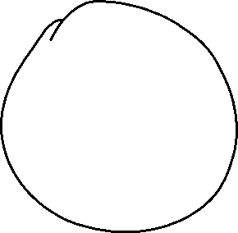




Slide 12


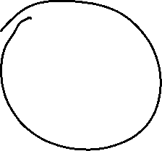


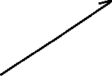


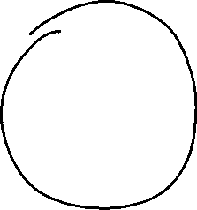



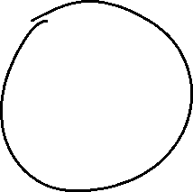

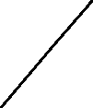






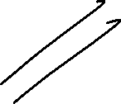
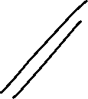

Slide 13
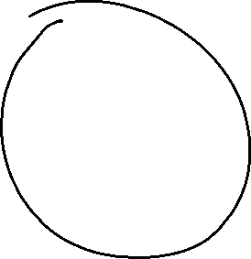
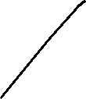
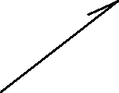


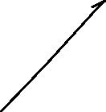




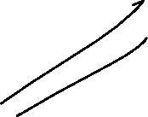

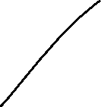


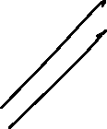
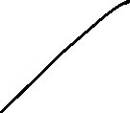



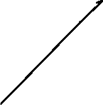

Slide 14




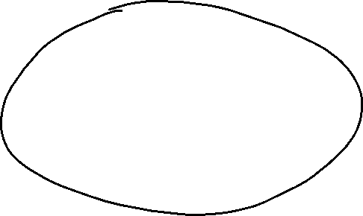
















Slide 15










Slide 16




Slide 17





Slide 18



Slide 22
#LifeKoKaroLift
Thank You!

